Slide 1

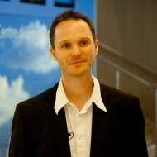
Serverless
Rainer Stropek
software architects gmbh
Web
Mail
Twitter
http://www.timecockpit.com
rainer@timecockpit.com
@rstropek
Event-Driven Serverless Microservices in Azure

Slide 2
Why?

Slide 3
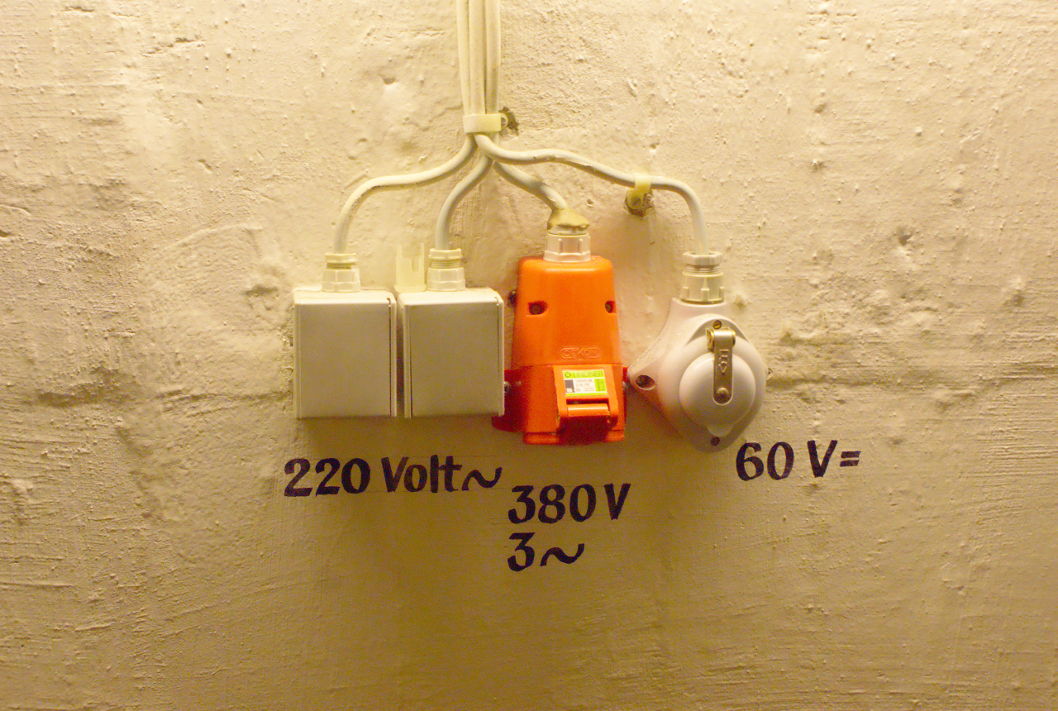
Image Source: https://flic.kr/p/73eSV7

Slide 4
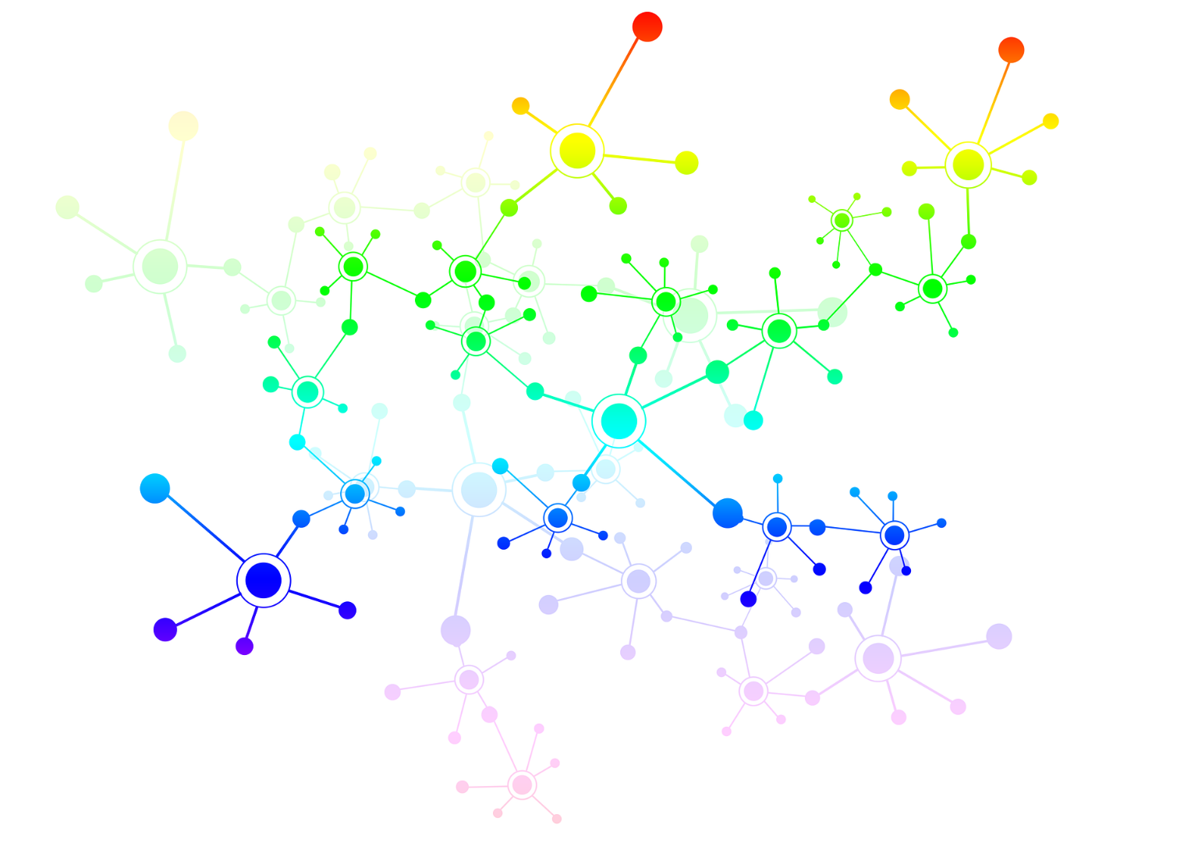
Microservices

Slide 5

Reactive Programming

Slide 6

Image Source: https://flic.kr/p/5qtj4r

Slide 7
Why Not?

Slide 8

Trust is Required
Image Source: https://flic.kr/p/9nWs1

Slide 9
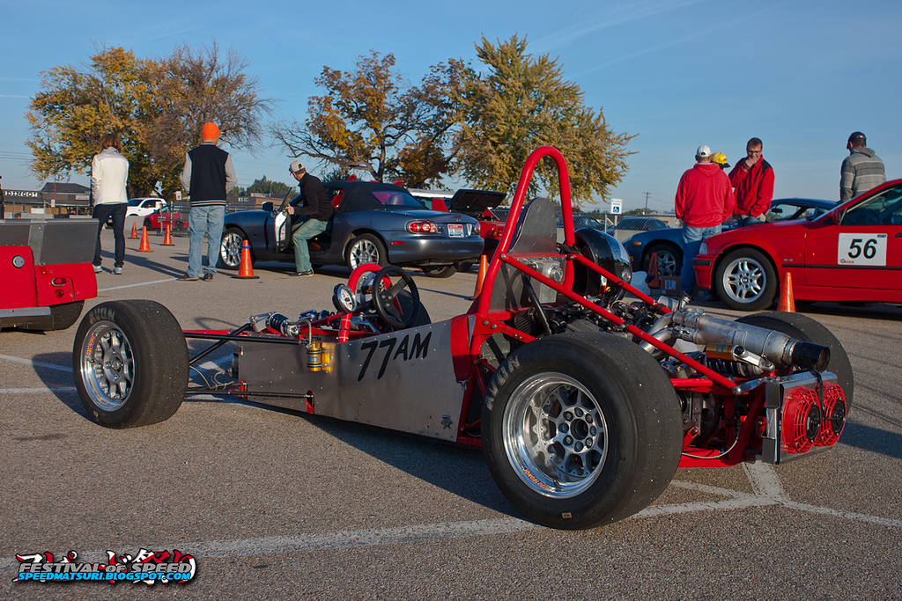
Specific Needs
Image Source: https://flic.kr/p/gWCWqU

Slide 10
Demos
https://github.com/rstropek/Samples/tree/master/AzureFunctions/TrafficMonitor

Slide 11
Summary

Slide 12
Image Source: https://flic.kr/p/73eSV7

Slide 13
Questions?
Thank you for coming!

